Slide 1
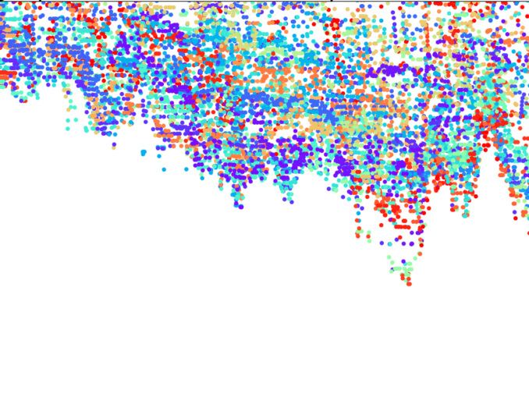
Openai projects to showcase in Resume
By Amrita Panjwani

Slide 2
Project 1: AI-Powered Content Summarizer
Problem Statement: The goal of this project is to build an AI-powered content summarizer that can take a lengthy text as input and generate a concise summary that captures the main points of the content.
Solution:
Utilized the OpenAI GPT-3 API to create an interactive conversational system.
Developed a user-friendly web application using Streamlit to provide an intuitive interface for users.
Users can input large blocks of text into the application, and the AI-powered summarizer processes the text using GPT-3 API calls.
The generated summary is displayed to the user, enabling them to obtain quick insights from lengthy documents.
Tools Used:
Python, Streamlit: Backend and frontend development for the web application.
OpenAI GPT-3 API: To perform natural language processing and generate summaries.

Slide 3
Project 2: Chatbot for Customer Support
Problem Statement: The objective of this project is to create a conversational chatbot that can provide real-time customer support, answer frequently asked questions, and guide users through common troubleshooting steps.
Solution:
Implemented a chatbot using the OpenAI GPT-3 API to handle user queries and respond with relevant information.
Developed a user-friendly web application using Streamlit to provide an interactive and conversational interface.
Deployed the chatbot on the web application, allowing users to interact with it seamlessly.
Tools Used:
Python, Streamlit: Backend and frontend development for handling API calls and building the interactive interface.
OpenAI GPT-3 API: For natural language understanding and generating chatbot responses.

Slide 4
Project 3: Sentiment Analysis for Social Media Posts
Problem Statement: The goal of this project is to build a sentiment analysis tool that can determine the sentiment (positive, negative, neutral) of social media posts in real-time.
Solution:
Used the OpenAI GPT-3 API to analyze the sentiment of social media posts by converting the posts into appropriate prompts.
Developed a Python script with Streamlit to interact with the OpenAI API and display sentiment analysis results.
The Streamlit app allows users to input social media posts and view sentiment analysis results in real-time.
Tools Used:
Python, Streamlit: Backend and frontend development for handling API calls and creating the app interface.
OpenAI GPT-3 API: For analyzing the sentiment of social media posts.

Slide 5
Project 4: AI-Generated Creative Writing
Problem Statement: The objective of this project is to create an AI-driven creative writing assistant that can generate poetry or short stories based on a given theme or style.
Solution:
Employed the OpenAI GPT-3 API to generate creative writing pieces.
Developed a Python script with Streamlit to enable users to specify the theme or style of the writing.
Users can interact with the Streamlit app, which communicates with the OpenAI API to return creative writing pieces based on the provided input.
Tools Used:
Python, Streamlit: Backend and frontend development for handling API calls and building the app interface.
OpenAI GPT-3 API: For creative writing generation based on user input.

Slide 6
Project 5: AI Songwriting Assistant
Problem Statement: Build an AI-powered songwriting assistant that generates lyrics based on user input.
Solution:
Utilize the OpenAI GPT-3 API to prompt the model to create song lyrics in different genres.
Develop a user-friendly Streamlit app that enables users to specify the genre, mood, and lyrical themes for the AI to base its lyrics on.
Provide users with the generated song lyrics, which they can use as inspiration or starting points for their own compositions.
Tools Used:
Python, Streamlit: Backend and frontend development for handling API calls and creating the app interface.
OpenAI GPT-3 API: For generating song lyrics.
NLP libraries (e.g., NLTK): For text processing and analysis.

Slide 7
Project 6: AI-Driven Storyteller
Problem Statement: Create an AI-driven storytelling system that generates captivating short stories.
Solution:
Utilize the OpenAI GPT-3 API to prompt the model to generate stories based on different themes or plot elements.
Develop a Python script with Streamlit to allow users to input story elements and receive a generated short story in real-time.
Implement natural language processing techniques to ensure coherence and creativity in the generated stories.
Tools Used:
Python, Streamlit: Backend and frontend development for handling API calls and building the app interface.
OpenAI GPT-3 API: For generating short stories.
NLP libraries (e.g., spaCy): For processing and enhancing the generated text

Slide 8
Project 7: Image Captioning with DALL-E
Description: Build an image captioning system using DALL-E that takes an image as input and generates a descriptive caption for the image.
Solution:
Fine-tune the DALL-E model on a dataset of images and corresponding captions to train it for the captioning task.
Develop a Python web application using Streamlit where users can upload images and receive generated captions.
Use image processing libraries (e.g., PIL) to preprocess the uploaded images before feeding them to the DALL-E model.
Tools Used:
Python, Streamlit: Backend and frontend development for the web application.
DALL-E: For generating image captions.
Image processing libraries (PIL): For preprocessing the uploaded images.

Slide 9
Project 8: DALL-E Chatbot for Visual Concepts
Description: Build an interactive chatbot that can have conversations about visual concepts and generate images based on textual prompts.
Solution:
Fine-tune the DALL-E model on a diverse dataset of images and corresponding textual descriptions to train it for visual concept understanding.
Develop a conversational Streamlit app where users can have a dialogue with the DALL-E-powered chatbot about visual concepts and receive AI-generated images.
Implement natural language processing techniques to handle conversations effectively.
Tools Used:
Python, Streamlit: Backend and frontend development for the chatbot interface.
DALL-E: For understanding visual concepts and generating images.
NLP libraries: For processing user input and maintaining conversation context.

Slide 10
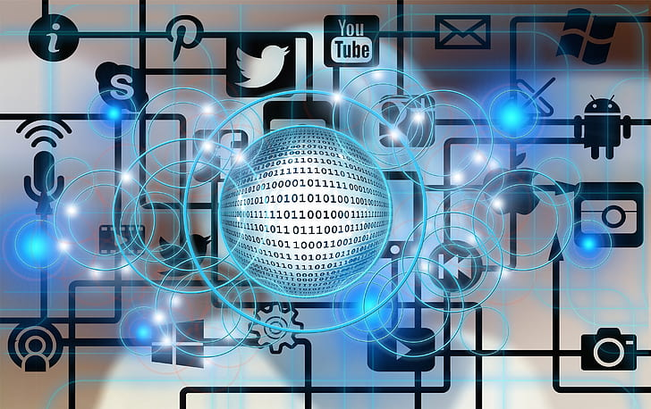
Showcase your projects on:
Github
Kaggle
Linkedin

